Slide 1


Data Collection

Slide 2
References csv
Contains all the relevant information by which you can find the article/articles where the data is presented.
Always contains the doi(if it exists), the author, the year the article was published, the paper url and the data url where you can access the datasets directly using the information given in this file.
doi | author | year | paper_url | data_url
NA | Diego P. Vazquez | 01/05/2002 | https://trace.tennessee.edu | http://www.ecologia.ib.usp.br/iwdb/html/vazquez_2002.html
10.1046/j.1461-0248.2003.00534.x | Diego P. Vazquez | 30/10/2003 | https://onlinelibrary.wiley.com/doi/10.1046/j.1461-0248.2003.00534.x | http://www.ecologia.ib.usp.br/iwdb/html/vazquez_2002.html
10.1086/339991 | Diego P. Vazquez | 01/07/2002 | https://www.researchgate.net/publication/23174889_Ecological_Specialization_and_Susceptibility_to_Disturbance_Conjectures_and_Refutations | http://www.ecologia.ib.usp.br/iwdb/html/vazquez_2002.html

Slide 3
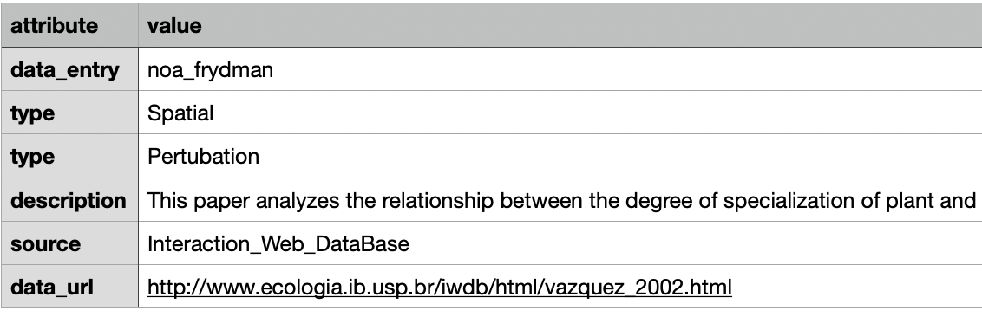
Description csv
In this file you will find who created this data entry: Noa or Ofir. This way you know who to direct question about the code.
Also, it will contain the type of network in question: spatial, temporal ect.
The file may contain a description line where you can get a better understanding of what the data and article are about.
Finally, the file also contains the source of the data and the url to that source.

Slide 4
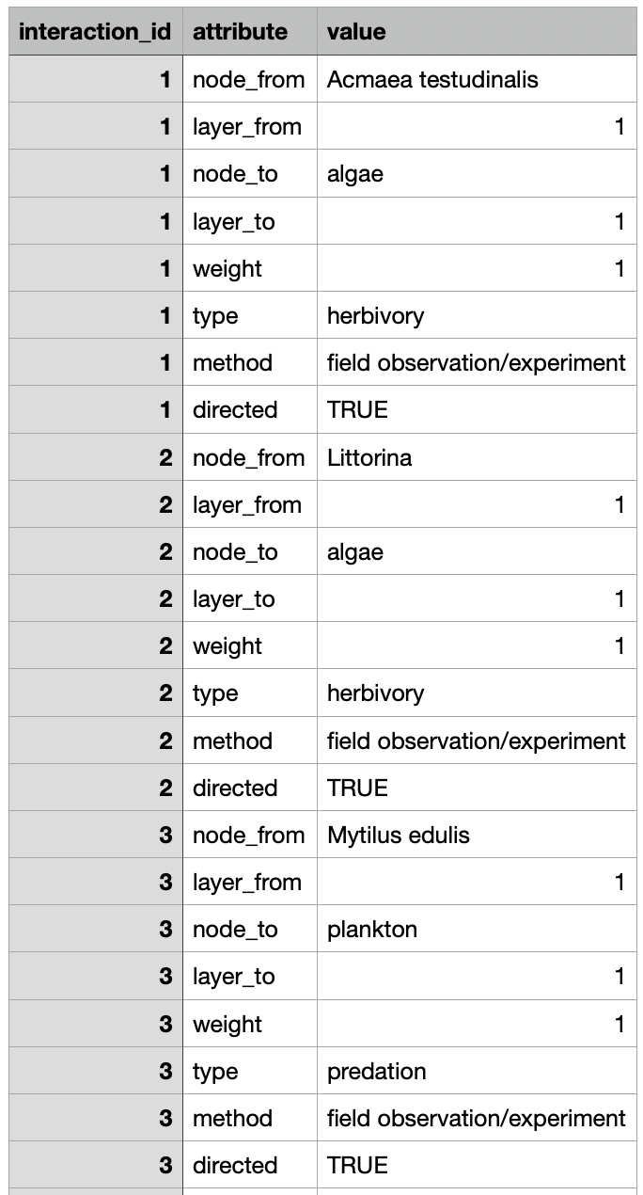
Interactions csv
Shows the interactions present in the data. May contain interlayer edges in addition to intralayer edges.
May be directed or undirected (undirected is default)
Always contains: the nodes(organisms that are involved in the interaction), the layers(from which to which layer the interaction occurs), type(e.g. seed-dispersal),weight(can be either binary or quantitative).
Can also contain additional information about the specific interaction: e.g. ‘directed’, ’method’.
Each interaction is labled with an interaction id.

Slide 5
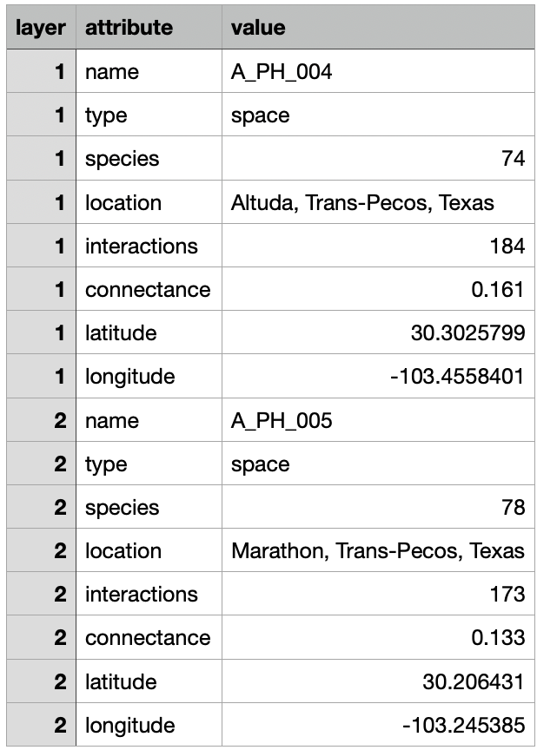
Layers csv
Represents the layers that make up the network.
Always contains: name, type (space,time,environment, ect).
May contain information about the layer such as its coordinates (longitude and latitude), the number of species present in said layer and more.

Slide 6
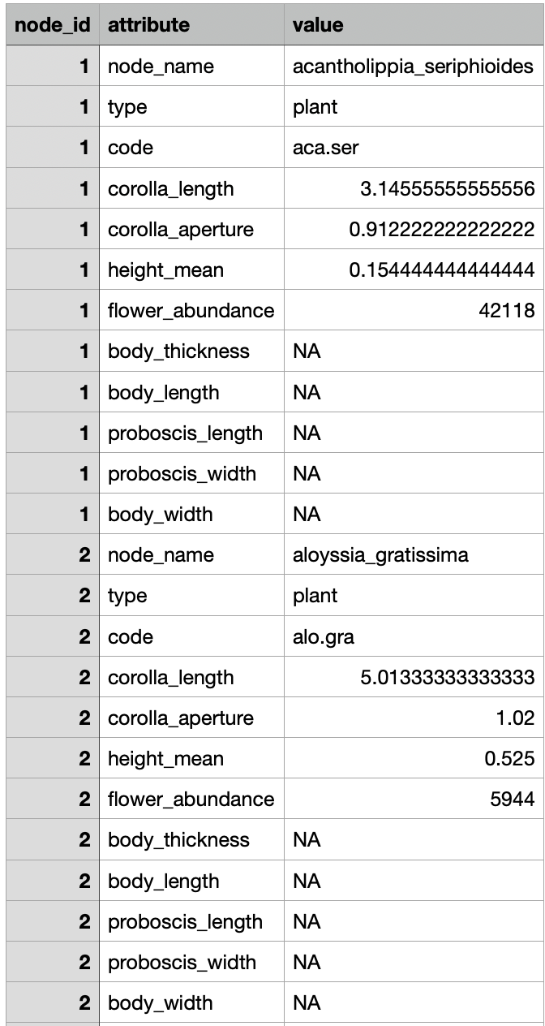
Nodes csv
Represents physical nodes and NOT state nodes.
Always contains: node_name and type (e.g. plant, pollinator ect.)
May contain more information about the nodes like the corolla length of the flower in plant nodes or the body length in pollinator nodes.
Each node is labled with node id.

Slide 7
Requestes
In the files, there are several areas of data missing where I can use your help in filling.
When you are using the data and are reading the paper, it will be helpful if you:
  Check if the description.csv has the description line filled; if not, then it will be very helpful if you wrote a line describing the article in question from your brief reading of it.
  In addition, if you come across the method by which the data was collected and it is not documented in interactions.csv, I will appreciate if you add a ‘method’ attribute to the file.
You are more than welcome to come to me with any questions about the data and I will welcome corrections and notes to my work.

Slide 8
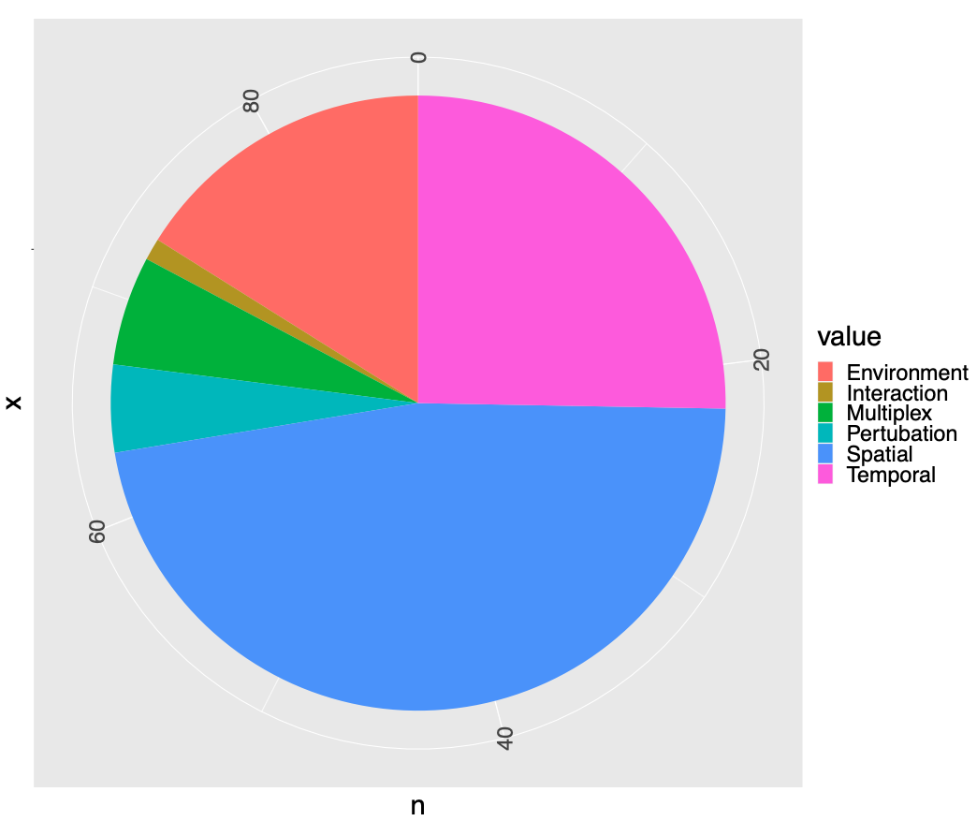
Network Types

Slide 9
Number of layers per paper

Slide 10
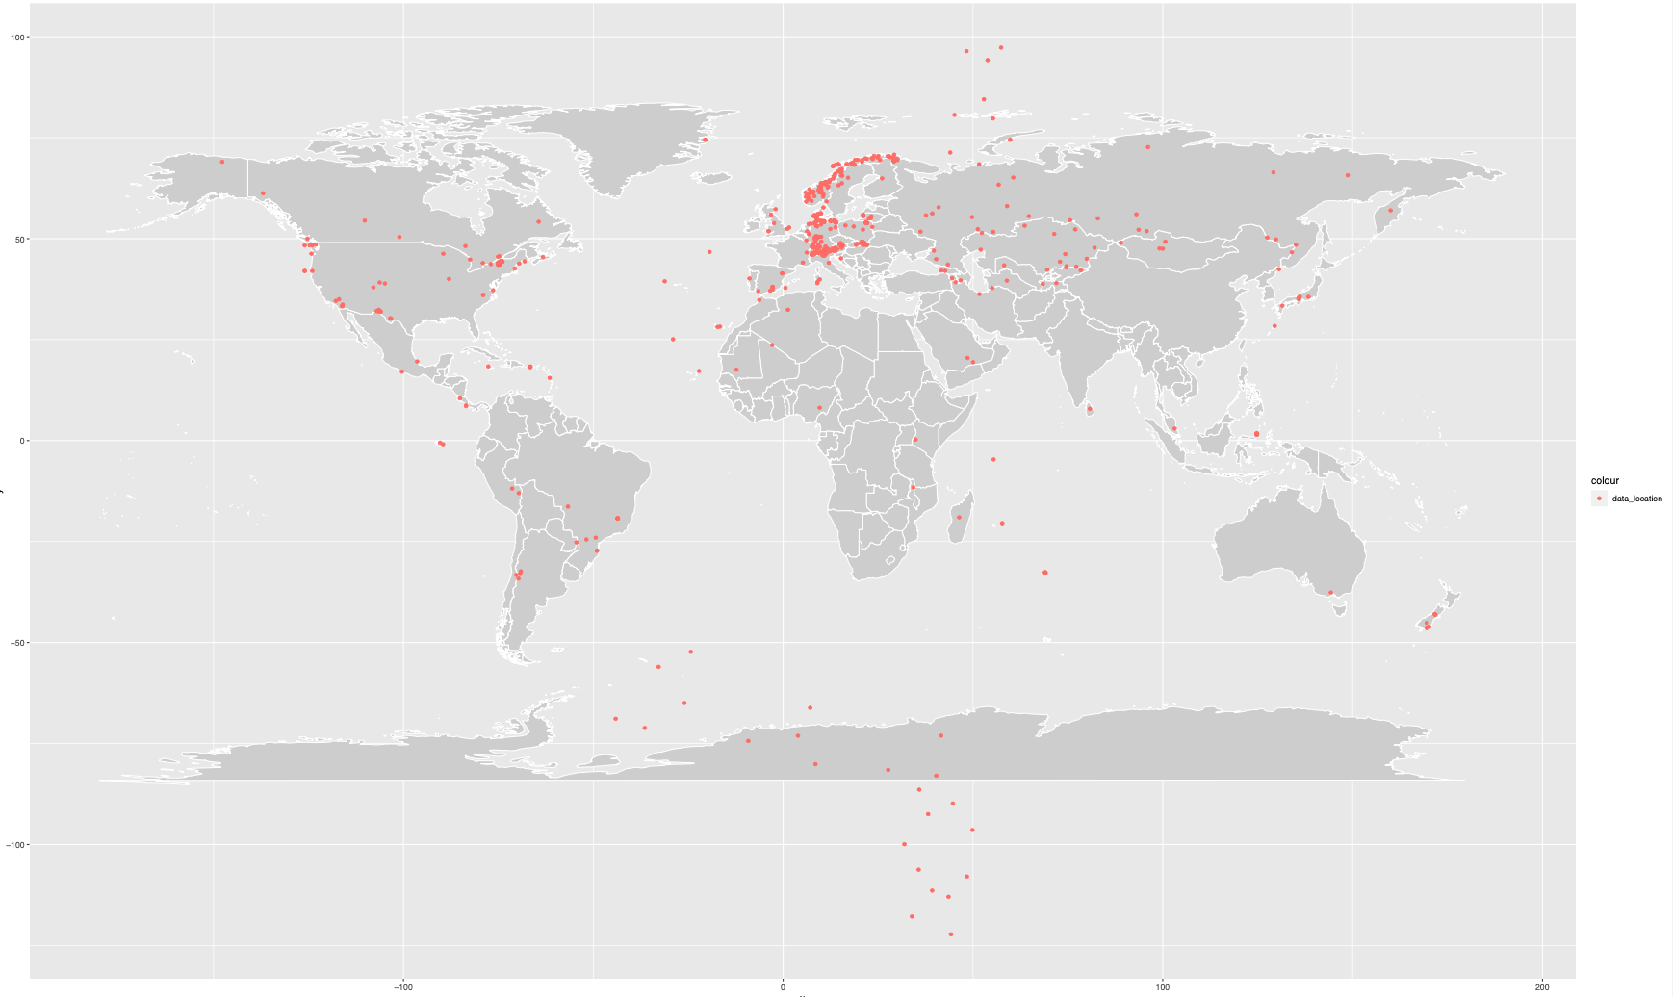
Study site locality map

